Slide 1

UVM for K Means IP
Project by:
Liora Huf
Eddy Sraiber
Supervised by:
Goel Samuel

Slide 2
Content
Hardware Verification
UVM
DUT
Implemented UVM Environment
Test Plan
Tests Results
Bug Fixes
Coverage Results
Summary and Conclusion

Slide 3
Hardware Verification – Motivation
Ensure that the devices performs required task successfully:
Device should reflect accurately the specification.
Bugs are a result of the discrepancy between the device design and the device specification.
Design verification (DV) contains different technologies and methodologies:
UVM (Universal Verification Methodology)
UPF (Unified Power Format) low-power verification
AMS (analog/mixed signal) verification
In this project, the chosen method for design verification is UVM.

Slide 4
UVM
UVM’s primary advantages are specifications and lays out of guidelines to be followed for creation of verification testbenches.
Above fact ensures:
testbench uniformity between different verification teams.
cross-compatibility between IPs.
standalone environment integration.
flexibility and ease of maintaining testbenches.
Every verification environment has similar components like drivers, monitors, transactions and scoreboards.
UVM provides a basic class for those components, along with standardized functions to instantiate, connect and build the test bench environment.
UVM also provides a mechanism named Factory used to create instances which makes the class override operation simple and easy.
Notes:
The primary advantage of the UVM is that this methodology specifies and lays out a set of guidelines to be followed for creation of verification testbenches. This fact ensures testbench uniformity between different verification teams, cross-compatibility between IPs and standalone environment integration, as well as flexibility and ease of maintaining testbenches.
Every verification environment has similar components like drivers, monitors, stimulus generators and scoreboards. UVM provides a build in base class for each of these components with standardized functions to instantiate, connect and build the test bench environment.

Slide 5
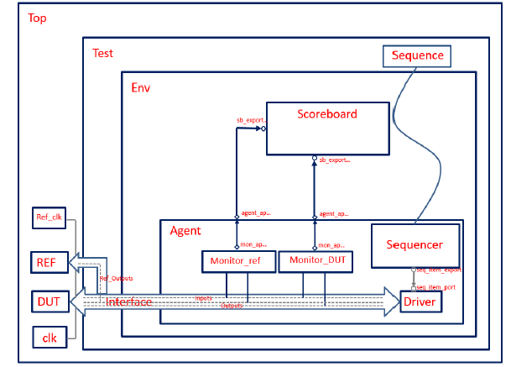
UVM Structure
The UVM usual structure is constructed with the following classes:
Top block
Sequence
Sequencer
Driver
Monitor
Agent
Scoreboard
Env
Test

Slide 6
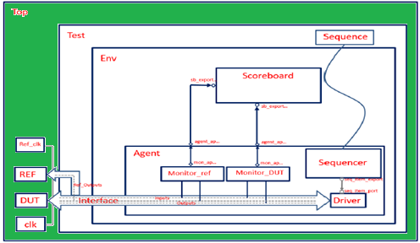
UVM Structure - Top block
Responsibilities:
Create instances of DUT, Reference model, and testbench.
Declare the virtual interface – a bridge between the Test component and the DUT/Reference Model.
Connecting the DUT and Reference Model to test , using interface.
Generating the clock for the DUT.
Registering the interface in the UVM factory. This is necessary in order to pass this interface to all other classes that will be instantiated in the testbench.
Running the test.
Notes:
Eddy Removal to here:
(The interface is a module that holds all the signals of the DUT. The monitor, the driver and the DUT are all going to be connected to this module.)
The top block will create instances of the DUT, the Reference model and of the testbench. It will also declare the virtual interface, which will act as a bridge between the Test component and the DUT/Reference Model.
The interface is a module that holds all the signals of the DUT. The monitor, the driver and the DUT are all going to be connected to this module.
This block will be a typical SystemVerilog module and it will be responsible for:
Connecting the DUT and Reference Model to the test class, using the interface defined before.
Generating the clock for the DUT.
Registering the interface in the UVM factory. This is necessary in order to pass this interface to all other classes that will be instantiated in the testbench. It will be registered in the UVM factory by using the uvm_resource_db method and every block that will use the same interface, will need to get it by calling the same method.
Running the test.

Slide 7
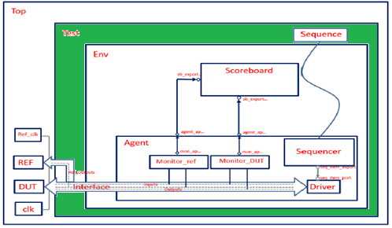
UVM Structure - Test
Derived from the uvm_test class.
Have two main purposes:
Create the env block.
Connect the sequencer, sequence blocks:
Connecting them here allowes easy manipulation of data transformation from sequencer to DUT, without any changes to be made at of agent’s code or sequence’s code.
Notes:
Eddy Removal to here:
The connected in this block, instead of the agent block or the sequence block because by specifying in the test class which sequence is going to be generated in the sequencer, the kind of data is transmitted to the DUT can be easily changed, without any change in the agent’s or sequence’s code.

Slide 8
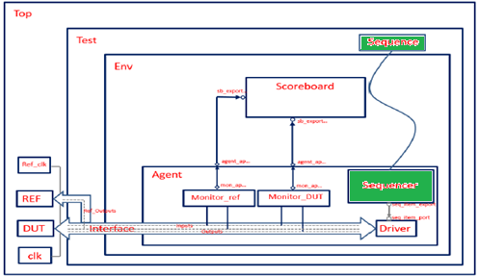
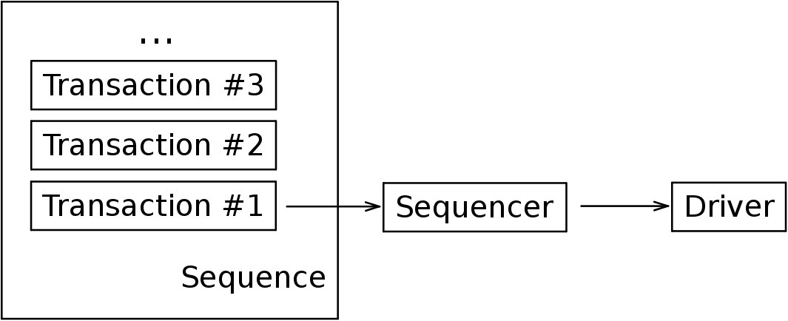
UVM Structure Sequence & Sequencer
A transaction is a class object which includes the information for communication between components.
Sequences are an ordered collection of transactions; they shape and generate them to our needs.
The sequencer transfers one transaction at the time from the sequence to the driver.
Notes:
Eddy change:
A transaction is a class object, usually extended from uvm_transaction or uvm_sequence_item classes, which includes the information needed to model the communication between two or more components

Slide 9
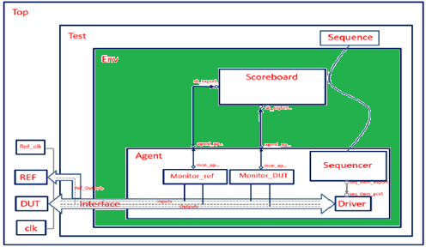
UVM Structure – Env
Instantiates the agent and the scoreboard and connects them together.
Such hierarchy allows separation from data transfer to data processing regarding the verification process.

Slide 10
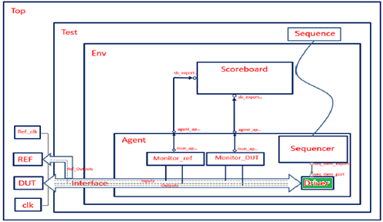
UVM Structure – Driver
Main role – interacting with the DUT.
Pulls transactions from the sequencer.
sends them repetitively to the signal-level interface.
This interaction will be observed and evaluated by another block, the monitor.
As a result, the driver’s functionality should only be limited to sending the necessary data to the DUT.

Slide 11
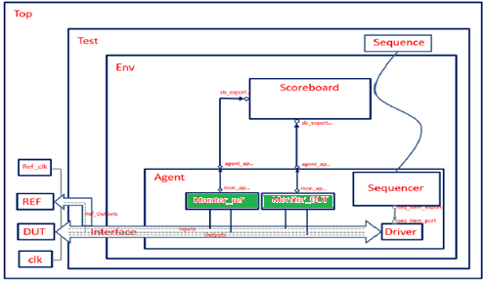
UVM Structure-Monitor
Observes communication of the DUT with the testbench.
Passive component.
Doesn’t drive any signals.
Its purpose is to extract signal information and translate it into meaningful information to be evaluated by other components.
Verification environment is not limited to just one monitor.
It can have multiple monitors.
In this project, the environment will have two monitors – for the DUT and for the Reference Model.
Monitors should collect the outputs of DUT, Reference Model.
Later, they will send them to the scoreboard.

Slide 12
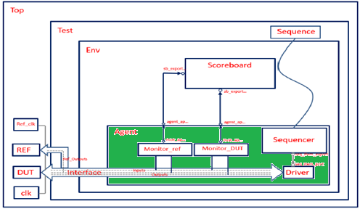
UVM Structure-Agent
Purpose:
Construct monitors, sequencer, and driver
Done in the build phase.
Create two analysis ports.
These ports are proxies for the monitors connections to the external scoreboard through the agent’s ports.
Using the concept of TLM ports, it can connect each port to its destination.
Notes:
The purpose of the agent module is to connect both monitors, the sequencer and the driver. An agent doesn’t require a run phase, there is no simulation code to be executed in this block but there will be a connect phase, in addition to the build phase.
The Agent component will construct the monitors, the sequencer and the driver in the build phase. It will also need to create two analysis ports, these ports will act as proxies for the monitors to be connect to an external scoreboard through the agent’s ports.
After it has constructed the components previously mentioned , the Agent has to make the connections between them. Using the concept of TLM ports, it can connect each port to its destination.

Slide 13
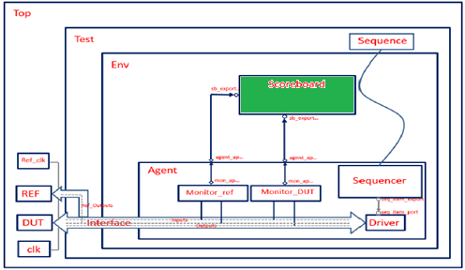
UVM Structure – Scoreboard
Verifies the proper operation of a design at a functional level.
In this project, the same inputs are driven into the DUT and into the Reference Model, and their outputs are monitored by the monitors.
The scoreboard then receives these outputs and compares them.
Some designers leave the prediction to the scoreboard.
Therefore, the functionality of the scoreboard is very subjective.
Contains two analysis exports corresponding to the two monitors were created in agent.
Used to retrieve transactions from both monitors.
A method compare() is executed in the run phase.
To compare both transactions. If they match, it means that the Reference Model and the DUT both agree on the functionality and it will return an “OK” message.

Slide 14
DUT Functionality – Motivation
Clustering is the classification of an object in different groups, or more precisely, the partitioning of a data set into subsets(clusters), so the data in each subset(ideally) share some common – often according to some defined distance measure.
K means clustering is a simple partition method to cluster n objects based on attributes into k partitions, where k<n.
K means clustering widely used in machine learning fields and image processing.
Each cluster is represented by the center of the cluster and the algorithm converges when stabilizing centroids of clusters.
Notes:
Clustering is the classification of an object in different groups, or more precisely, the partitioning of a data set into subsets(clusters), so the data in each subset(ideally) share some common – often according to some defined distance measure.
K means clustering is a simple partition method to cluster n objects based on attributes into k partitions, where k<n.
K means clustering widely used in machine learning fields.
Each cluster is represented by the center of the cluster and the algorithm converges when stabilizing centroids of clusters.

Slide 15
DUT – The K means algorithm
Given the cluster number K, the K-means algorithm is carried out in 4 steps:
Initialization: randomly setting the initial centroids.
Classification: assign each object to the cluster with the nearest centroid measured with a specific distance metric.
Centroid update: Compute new centroids of the clusters given the current partition.
Convergence check: Compare new centroids to the ones from last iteration:
If they “close” to each other (their norm difference does not proceed predetermined threshold), end the algorithm.
Else, start another iteration by returning to Classification step with the new centroids.

Slide 16
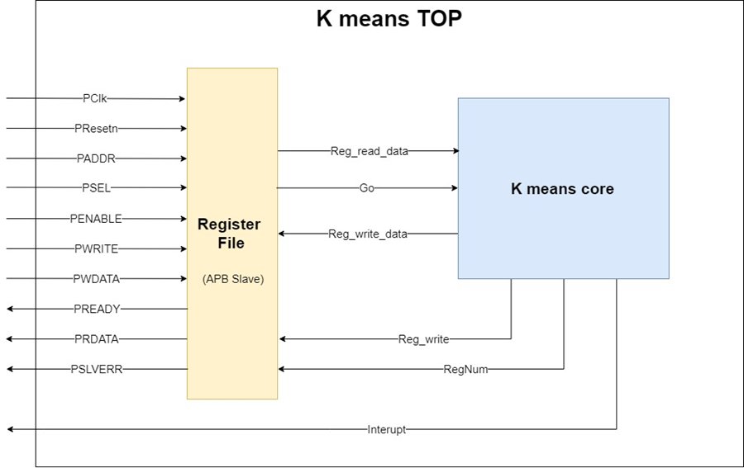
DUT - Architecture
The high-level architecture composed of two main modules:
The “Register file” – communication mediator, via APB protocol:
Communicate with the CPU host and store income data.
Communicate with “K means core”, and store output data.
The “K means core” – the “brain”.
Run the algorithm when getting a GO signal.
When finished – throw an interrupt to CPU host (passed through the “Register file”).

Slide 17
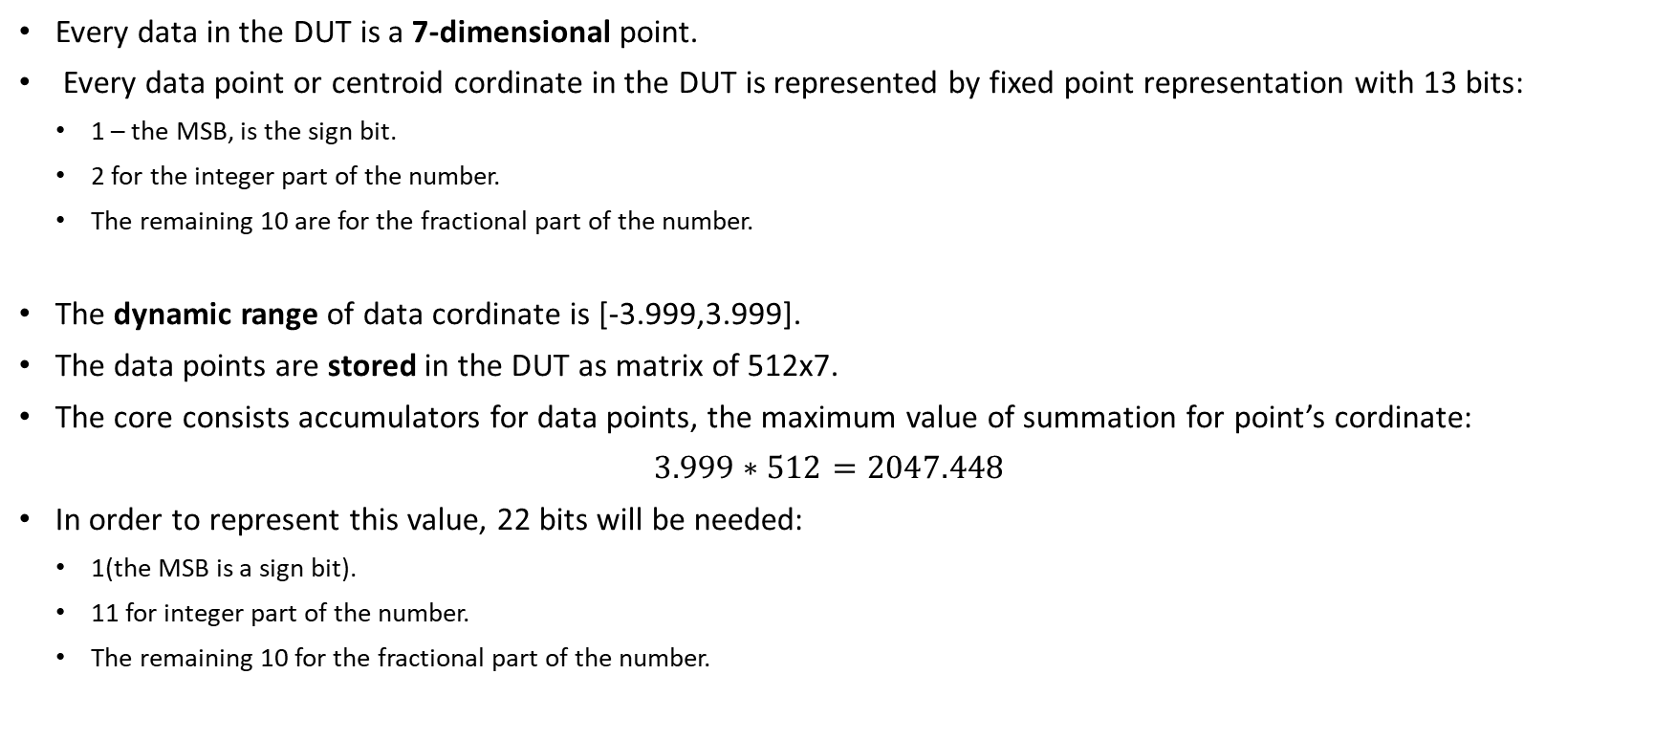
DUT - Input data characteristics
Every data in the DUT is a 7-dimensional point.
Every data point or centroid cordinate in the DUT is represented by fixed point representation with 13 bits:
1 – the MSB, is the sign bit.
2 for the integer part of the number.
The remaining 10 are for the fractional part of the number.
The dynamic range of data cordinate is [-3.999,3.999].
The data points are stored in the DUT as matrix of 512x7.
The core consists accumulators for data points, the maximum value of summation for point’s cordinate:
$3.999∗512=2047.448$
In order to represent this value, 22 bits will be needed:
1(the MSB is a sign bit).
11 for integer part of the number.
The remaining 10 for the fractional part of the number.

Slide 18
DUT - Parameters
One must configure(fill) the following parameters, Before sending the go signal:
At least 8 data points need to be written to the IP’s RAM.
The “First ram addr”, “Last ram addr” registers should be configured (not necessarily in this order).
Configuration of other parameters:
centroids value:
The default value for all centroids initial is zero.
Can be changed, by writing values to registers “Cent_X_reg”, where X is an integer between 1 and 8.
Threshold’s value:
Used for convergence check of the algorithm.
The default value for threshold is zero.
May be configured by user.
It can be configured by writing the desired threshold value to register “Thresh hold”.
Afterwards, sending the go signal will instruct the DUT to start its function.
To do so, user has to write the value ‘1’ to register named “Go_reg”.
Notes:
Before setting the “Go” register to 1, at least 8 data points need to be written to the IP’s RAM. The maximum Ram capacity is 512 data points, therefore, insertion of more than 512 data points may cause unexpected behavior.
Before setting the “Go” register to 1, the following registers need to be configured (not necessarily in this order):
First ram addr – this register must be configured to the first ram address in which the user wrote data.
Last ram addr - this register must be configured to the last ram address in which the user wrote data.
The maximum Ram capacity is of 512 data points, therefore the parameter “First ram addr” should be between 1 and 512. The parameters “Last ram addr” shall therefore be set to the sum of the parameter “First ram addr” and the number of points chosen by the user.
After performing the configurations described above, in order to instruct the DUT to start its function, the user must write the value ‘1’ to register named “Go_reg”.
The centroid initial values can be configured by writing these values to registers “Cent_X_reg”(X is an integer between 1 and 8),before the “Go_reg” is configured to ‘1’. In case these registers are not configured, all centroid initial values will be set to zero.
The threshold value used for convergence check of the algorithm may be configured by user. It can be configured by writing the desired threshold value to register “Thresh hold”. In case this register is not configured, the threshold value will be set to zero.

Slide 19
Implemented Environment - Transaction
Variable name | Type | Minimal Constraint | Purpose
Centroids | Rand logic [8][91] |  | Randomly generate initial centroid values.
Num_points | Rand int | Between 8 and 512. | Generate the number of input points.
Data_points | rand logic [512][91] |  | Generate input points values.
Threshold | rand logic [12:0] | threshold[12:8] == 5'd0 (so the threshold is small) | generate thresh – hold.
first_point_index | rand logic [13] | Between 1 to largest allowed so that we have at least Num_points as generated | First ram index where data points will be written to.
last_point_index | Rand logic [13] | Has to be sum of first idx with num of points. | Last ram index where data points will be written to.
Main transaction called Kmeans_transaction.
Derived from of the UVM built in class uvm_sequence_item.
Consists the following variables and constraints:

Slide 20
Implemented Environment - Sequence
Derived from the UVM built in class uvm_sequence.
The instance of sequence class was named Kmeans_in_sequence and consists:
Variable called num_txs – the number of Testbench’s transactions.
At each instantiated new transaction, the randomize function will generate all “rand” type related variables.
Afterwards, the transaction sent to the driver, waiting for him to finish.
When the driver finishes the transaction, the driver reports the sequencer, which then can send another one, and so on.
Notes:
Eddy change:
Afterwards, the transaction sent to the driver with the function start_item(thorught the sequencer)
When the driver finishes the transaction , the sequence ends this transaction with the function finish_item .

Slide 21
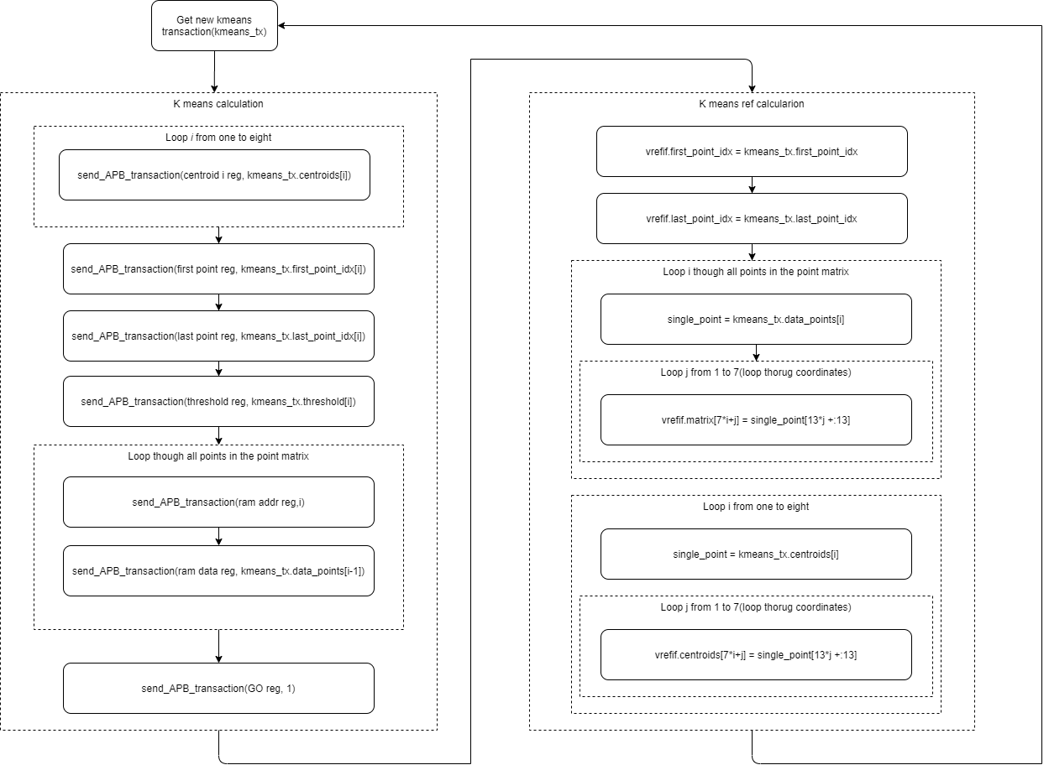
Implemented Environment - Driver
Driver instantiation named Kmeans_driver.
Derived from the UVM built in class uvm_driver.
Implements the following tasks in order to fullfill its purpose:
Notes:
Its purpose: (sending the transaction to the DUT and the Ref model):

Slide 22
Implemented Environment - Scoreboard
Implemented of scoreboard contains:
Two of each uvm_analysis_export and uvm_tlm_analysis_fifo.
Virtual functional named compare centroids
In Run task, calls the compare_centroids function to determine if a test run failed or passed.
Comparing the centroids of the DUT and the Ref Model.
Test Passes if the overall difference between all coordinates off all centroids is smaller than 16 times the value of the threshold.
The pass/fail condition was derived from the functionality of the DUT and Ref Model:
A set of centroid’s are announced as converged if the difference between them to last iteration’s set is smaller than the threshold.
Notes:
Eddy change:
Implemented of scoreboard contains:
Two uvm_analysis_export (one for the DUT centroids and one for the Ref Model centroids)
Two uvm_tlm_analysis_fifo (one for the DUT centroids and one for the Ref Model centroids)
Virtual functional named compare centroids
The Scoreboard implemented class contains:
Two uvm_analysis_export (one for the DUT centroids and one for the Ref Model centroids)
Two uvm_tlm_analysis_fifo (one for the DUT centroids and one for the Ref Model centroids)
Virtual functional named compare centroids
This class uses the uvm_tlm_analysis_fifo and uvm_analysis_export in order to get the results from the DUT and Ref Model (the eight centroids of each of them).
In is Run task, the Scoreboard class calls the function compare_centroids in order to determine if a test run failed or passed.
This function determines the result by comparing the centroids od the DUT and the Ref Model, if the overall difference between all coordinates off all centroids is smaller than 16 times the value of the threshold. The pass/fail condition was derived from the functionality of the DUT and Ref Model, which consider a centroid converged if the absolute value of the distance between it and the last iteration centroid is smaller than the threshold value.

Slide 23
Reference Model (1/2)
The Reference Model was written using Matlab.
A Matlab function named RefModel.m, performs the K Means algorithm.
The function receives five input parameters, all received with corresponding of DUT numeric representation model:
Data Points matrix with 512 rows and 7 columns.
Each row represent a point in the data set.
Initial centroids matrix with 8 rows and 7 columns.
Each row represents an initial centroid value.
Threshold value.
First point index of RAM.
Last point index of RAM.
Notes:
The Reference Model used to check the DUT results was written using Matlab. It is Matlab function named RefModel.m. This functions implements the K Means algorithm in software.
The RefModel.m function receives five input parameters:
Point input matrix with 512 rows and 7 columns, where each row represent a point in the DUT numeric representation model, i.e. each row is a point with 7 dimensions, each dimension is a fixed point number with 13 bits(MSB is the sign bit, the following two bits represent the integer value and the remaining ten bits represent the fractional part)
Initial centroid matrix with 8 rows and 7 columns, where each row represents an initial centroid value in the DUT numeric representation model.
Input threshold value in the DUT numeric representation model
First point index
Last point index

Slide 24
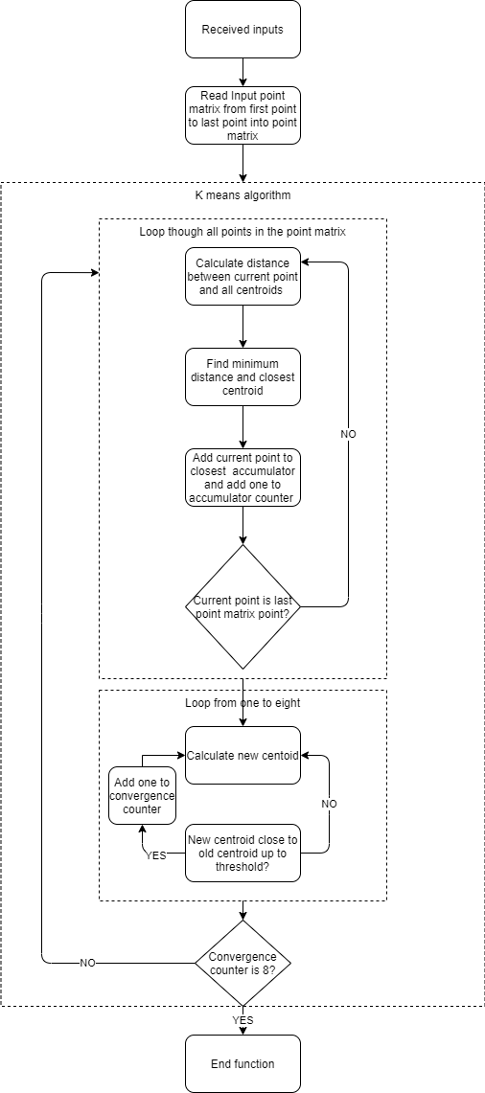
Reference Model (2/2)
The parameters are used in the following way:
The function reads the points values from the “First point index” till the “Last point index” into another matrix, named point matrix.
Then, the function interactively executes the algorithm using the following parameters:
point matrix.
“initial centroid matrix”
“Threshold”.
The following figure summarizes the Reference Model in a flow chart:
Notes:
These parameters are used in the following way: the Reference model function uses the Point input matrix as the DUT uses its RAM, it read the points values from the “First point index” till the “Last point index” into another matrix, named point matrix , which will be used to run the algorithm.
Then the function interactively executes the algorithm using the point matrix, the “input centroid matrix” and the “input threshold”.
The following figure summarizes the Reference Model in a flow chart:

Slide 25
Test Plan – Verifying APB Protocol
Purpose: Verify the functionality of the communication with the DUT.
An early test was done, separately from the following test plan.
All registers of the DUT Reg File were written to and read from.
This test was successful, leading to the conclusion that the communication protocol with the DUT works correctly.

Slide 26
Test Plan – Test Scenarios
In the following slides there would be a numerical order of different test scenarios.
Each Test Scenario detail here was built and run.
The purpose of these test lines is to test the main functionality of the DUT.
The pass/fail criteria are handled by the scoreboard.
In each test scenario, different parameters are set
These parameters are sent to the DUT and the REF Model.
The outputs from both are compared.
They are considered equivalent if every output centroid from each set has a corresponding “close” centroid in the other set (up to threshold value).

Slide 27
Test Plan – Test Scenarios
Test Scenario Number | Test Scenario Name | Random Generated Paraments | Constrains
1 | Gradual Random Points | Centroids one to eight Threshold value will be one Ten data points. | Centroids one to eight will be set to values 1 to 8(respectively) Threshold value will be one (only threshold LSB will be one). First only one data point will be random. At each iteration, one more data point will be randomly generated.
2 | One Iteration Test | 1. Eight values | These eight values will be used both as points values and initial centroid values.
3 | Random Points and Centroids | Eight Points values Eighth initial Centroid values | Eight Points values will be randomly generated Eighth initial Centroid values will be randomly generated

Slide 28
Test Plan – Test Scenarios
Test Scenario Number | Test Scenario Name | Random Generated Paraments | Constrains
4 | Random Constrained Number of Points | Number of points Points values Initial Centroid values | This test will be run overall ten times, where in each run the constraint over the Number of Points parameters will change.
5 | Equal Initial Values Test | Number of points Points values A single value which will be used as an initial value for all centroids.
6 | Positive Overflow Test | Initial Centroid values | 512 data points will be generated and set to have maximum allowed value.

Slide 29
Test Plan – Test Scenarios
Test Scenario Number | Test Scenario Name | Random Generated Paraments | Constrains
7 | Negative Overflow Test | Initial Centroid values | 512 data points will be generated and set to have minimum allowed value.
8 | Full Memory Test | 512 points values Initial centroid values
9 | Fully Random Test | Number of points Points values Initial Centroid values

Slide 30
Test Plan – Test Scenarios
Test Scenario Number | Test Scenario Name | Random Generated Paraments | Constrains
10 | Isolated Centroid Test | Number of points Points values Initial Centroid values | One of the centroids is constrained to be far away from the all the data points. All of the centroids, except from one, are constrained to be far away from the all the data points.
11 | Robustness Test | Number of points Points values Initial Centroid values
12 | Threshold Test | Number of points Points values Initial Centroid values Convergence threshold value

Slide 31
Test Plan – Test Results
Test Scenario Number | Number of tests | Fail number | Fail Percent [%]
1 | 10000 | 23 | 0.23
2 | 10000 | 0 | 0
3 | 10000 | 4 | 0.4
4 | 11 | 4 | 36.36
5 | 10 | 5 | 50
6 | 10 | 0 | 0
7 | 10 | 0 | 0
8 | 10 | 9 | 90
9 | 10 | 3 | 30
10 | 10 | 6 | 60
11 | 10000 | 1941 | 19.41
12 | 10 | 0 | 0

Slide 32
Bug Fixes (1/3)
Negative values bug:
While building the verification environment, a “sanity check test” done.
It was done in order to verify if the UVM environments works.
The results from the DUT indicated a bug.
This bug was apparently related to the DUT’s inability to recognize negative values.
This bug was fixed by the following steps:
Fix sign representation of variables
Fix 2's complement representation of numbers

Slide 33
Bug Fixes (2/3)
Combinatorial sensitivity list missing item bug:
In convergence_check_block:
The new calculated centroids of each iteration are compared to former iteration’s centroids.
It is a step for a decision of reaching convergence.
Whether convergence was reached or not, the new centroids are defined as the algorithm current centroids.
The module consists a sensitivity list:
Expected behavior – take one old centroid from the 8 and compare it to the correspondingly new centroid.
This sensitivity list did not cover the change in values of the relevant inputs.
It did not represent a supposedly combinatorial representation of always block.
The following change was done to solve the problem:
Before: "always @(cent_num) begin".
After: "always @* begin".
Notes:
In convergence_check_block, the new calculated centroids of each iteration are checked for convergence by comparing them to the last iteration’s centroids values(one by one). In the case where convergence was not reached, the new centroids are used in the next iteration as the algorithm centroids.
In the convergence check module, there is a sensitivity list used to take one old centroid from the 8 and compare it to the correspondingly new centroid which come as input from prior module (new means calculation block).
This sensitivity list did not cover the change in values of the relevant inputs for this supposedly combinatorial representation of always, the following fix was done to solve the problem:
Before: "always @(cent_num) begin".
After: "always @* begin".

Slide 34
Bug Fixes (3/3)
Correction of wrong synchronization for controller FSM signal toggle:
The controller has a signal for enabling the accumulators of the pipe3 of classification block.
The signal determines when to sample data point, which comes as input from the RAM to the classification block.
After the last data point reached the last pipe stage, no more data should be sample by the accumulators.
Therefore, the enable needs to be turned off so at that in the next state, there would be no sampling of any more data points.
The bug was that the DUT sampled one more data point then needed.
It was in the 2nd state of “empty_pipe”.
Disabling the enable signal one state/cycle earlier, removed the bug.
Notes:
The controller has a signal for enabling the accumulators of the pipe3 of classification block. The signal is in charge of determining when to sample data point, which comes as input from the RAM to the classification block.
After the last data point reached the last pipe stage, no more data should be sample by the ccumulators(“garbage” data may be present in the pipe) . Therefore, there is a need to pull down the enable so at that in the next state, which is "calculate new means", there would be no sampling of any more data points.
There was a bug which we sampled one more data point since we pulled down the signal only at the "calculate new means" state. Pulling it down one state/cycle earlier, removed the bug.

Slide 35
Coverage
Motivation:
The testcase pass/fail results are used to measure the verification status.
They are limited in terms of randomness.
The engineer should verify that the test fully cover the defined constrains.
Therefore, test coverages are defined.
The types of verification coverage:
Code Coverage.
Condition Coverage.
Functional Coverage.
FSM Coverage.
Notes:
Code Coverage (which lines of code are executed)
Condition Coverage (whether all branches of conditions have been exercised.)
Functional coverage (how much design functionality has been exercised/covered by the testbench or verification environment)
FSM Coverage (which states and possible state transitions are exercised)

Slide 36
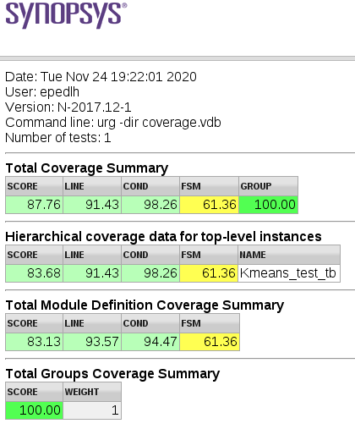
Coverage results
Coverage was performed to the test line called Robustness.
It is the most “random” test line.
It has the biggest number of tests.
The total coverage results can be seen in the following figure:
Notes:
It is the most “random” test line(every input for the DUT is randomly generated) and it has the biggest number of tests.

Slide 37
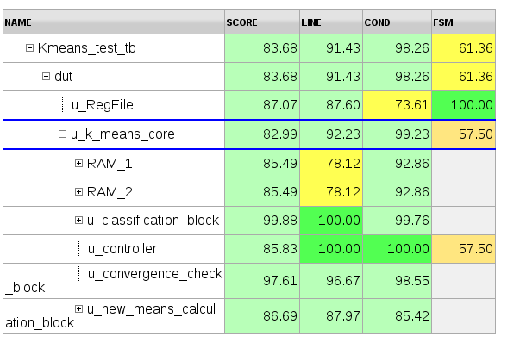
Code Coverage
Total code coverage was 91.43%.
The following figure details the code coverage from the DUT modules:

Slide 38
Conditional Coverage
Total code coverage was 98.26%.
Uncovered conditionals come from the following modules:
Reg File
RAM
Classification block
Convergence check block
New means calculation block

Slide 39
Functional Coverage
In order to check the functional coverage of the test line, the following cover groups were defined:
NUM_POINTS - Samples the number of data , to verify that all values of this variable are uniformly distributed between 8 and 512.
DATA_VALUE – Samples the values of each one of the seven coordinates of all data points ,to verify that all values of this variable are uniformly distributed between all the possible values.
CENTX_VALUE - Samples the value of each one of the seven coordinates of centroid X,to verify that all values of this variable are uniformly distributed between all the possible values.
Notes:
In order to check the functional coverage of the test line, the following cover groups were defined:
NUM_POINTS - This cover group samples the number of data points randomly generated for each test, to verify that all values of this variable are uniformly distributed between 8 and 512.
DATA_VALUE - This cover group samples the values of each one of the seven coordinates of all data points randomly generated for each test, to verify that all values of this variable are uniformly distributed between all the possible values.
CENTX_VALUE - This cover group samples the value of each one of the seven coordinates of centroid X, randomly generated at each test, to verify that all values of this variable are uniformly distributed between all the possible values.

Slide 40
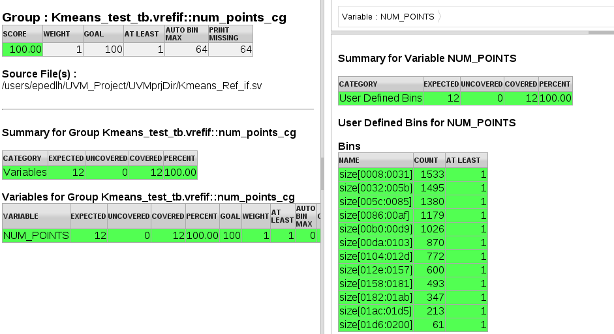
Functional Coverage number of points
The number of points in all the tests was approximately uniformly distributed between 8 and 512.

Slide 41
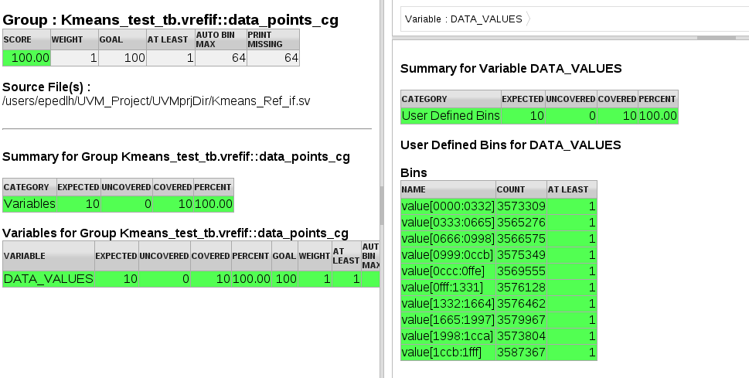
Functional Coverage data points
For all data points, the values of their coordinates were uniformly distributed between all the possible values in all the tests.

Slide 42
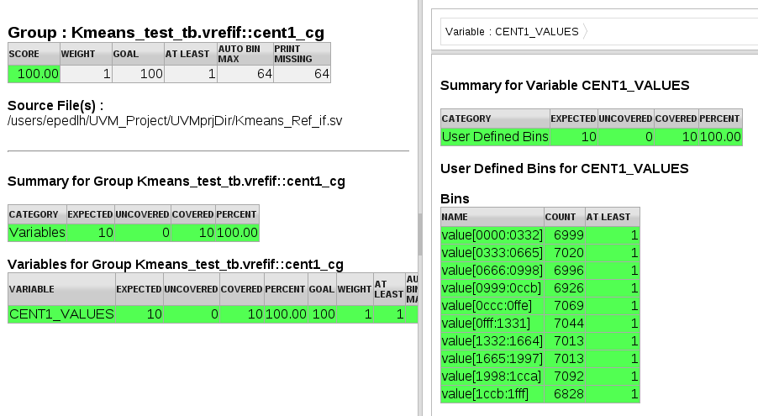
Functional Coverage centroids value
For centroid 1:
The values of its coordinates were uniformly distributed between all the possible values in all the tests.
That is also correct for the other 7 centroids.

Slide 43
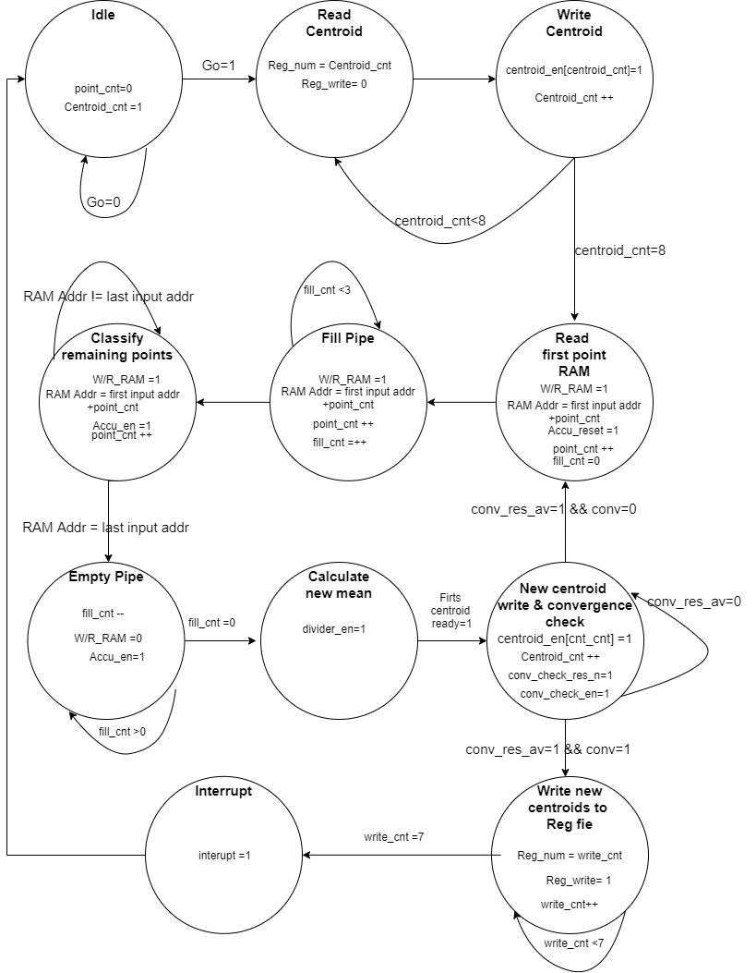
Coverage results – FSM Coverage
The default FSM coverage has a low result.
It checks all transitions for the FSM, illegal ones in particular.
Therefore, a cover group for the legal transitions was built.
The FSM presented in the DUT is the one inside the controller module.
The cover group for the valid transitions was written according to the transitions and control signals in the following figure, which describes the K means controller FSM:

Slide 44
Coverage results – FSM Coverage
The FSM states were named according to the following table:
Idle | S0
Read centroid | S1
Write centroid | S2
Read first point Ram | S3
Fill pipe | S4
Classify remaining points | S5
Empty pipe1 | S6
Empty pipe 2 | S7
Calculate new mean | S8
New centroid write & convergence check | S9
Write new centroid to Reg File | S10
Interrupt | S11

Slide 45
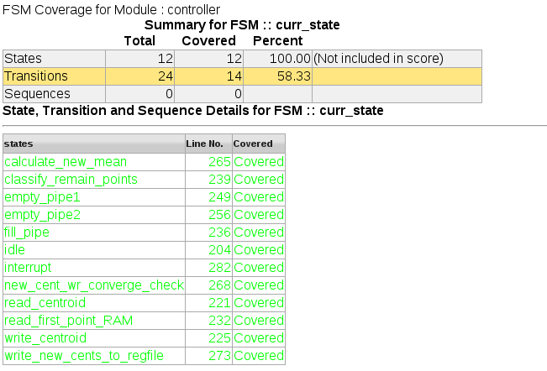
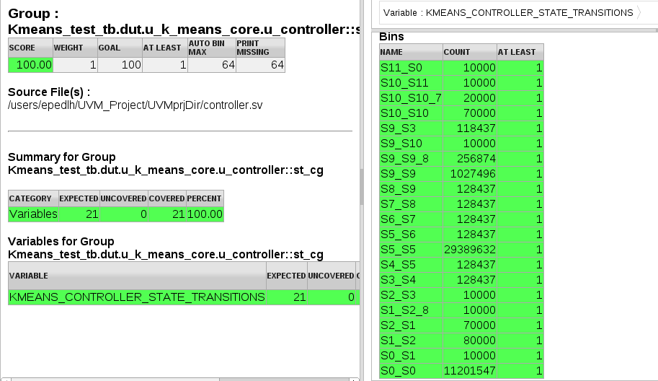
Coverage results – FSM Coverage
The states coverage was of 100%, as it can be seen in the following figures:

Slide 46
Summary & Conclusions
The tests results indicate that are bugs in the DUT:
The high fail rate in test line 8 indicates that there is an overflow bug when trying to fill the RAMs.
Test line 3 and 4 indicate that as the number of data points increases so does the number of fails.
This could be related to bugs such as:
Overflow.
Wrong classification of close points.
Wrong calculations.
Even though many test benches were run on the DUT in its design phase, many tests have failed.
This emphasizes the need for an efficient verification environment, as UVM, parallel to the design process.
UVM is an effective tool.
It is intuitive, with high level coding and easy to reuse, making the verification process simpler and faster.
Notes:
The tests results indicate that are still bugs in the DUT, which we were not able to find and fix. If the DUT was a commercial IP, we would advise the company to do a thorough debugging process.
The high fail rate in test line 8 indicates that there is an overflow bug when trying to fill the RAMs.
Test line 3 and 4 indicate that as the number of data points increases so does the number of fails. This could be related to bugs such as overflow, wrong classification of close points, and/or wrong calculations.
Even though many test benches were run on the DUT in its design phase, many tests have failed. This emphasizes the need for an efficient verification environment, as UVM, parallel to the design process.
UVM is an effective tool. It is intuitive, with high level coding and easy to reuse, making the verification process simpler and faster.

Slide 47
Thank you

